Slide 1
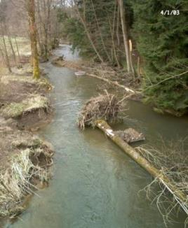
Selection of restoration measures
General principles and approaches Potential restoration measures Effects on river morphology and biota
Jochem Kail, University of Duisburg-Essen
Notes:
This presentation deals with the aspects that have to be considered in specific, single restoration projects for the selection of restoration measures.
Three topics will be covered:
present general principles and approaches that should be considered,
give an overview on the restoration measures that are available (catalogue of measures),
summarize what is known about the effect of these restoration measures on biota and how this may guide the selection of measures (implications for future restoration projects)

Slide 2
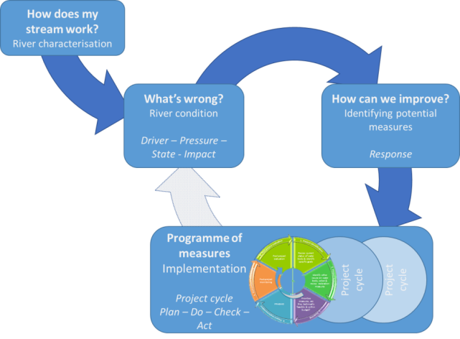
Setting the scene
Planning cycle – steps prior to selection of measures
How does my river work?
Natural river type
Reference conditions
What’s wrong?
What’s missing?
Hymo assessment
Bio assessment
What’s the reason? Why?
Identify limiting pressures
Difficult due to multiple-pressures
How can we improve? – select measures
Notes:
Show how this topic is linked to the other presentations.

Slide 3
Setting the scene
Planning cycle – two spatial and administrative levels
A: Programme of Measures (PoM) | B: Individual restoration projects
Catchment-scale | Catchment to reach-scale
All water bodies | Often single water bodies
Conceptual | Technical
Good chemical status is a must! | Have to work in given catchment context
Costs not limiting even in HMWB! (except less stringent environmental objectives) | Have to work given the property situation and financial constraints
Regional to national water agencies | Local river managers
A
B
Figure: N. Angelopoulos
Notes:
As shown in the REFORM planning cycle, the selection of measures is done at two different spatial and adiministrative levels.

Slide 4
Setting the scene
Planning cycle – presentation is about restoration at project level!
A: Programme of Measures (PoM) | B: Individual restoration projects
Catchment-scale | Catchment to reach-scale
All water bodies | Often single water bodies
Conceptual | Technical
Good chemical status is a must! | Have to work in given catchment context
Costs not limiting even in HMWB! (except less stringent environmental objectives) | Have to work given the property situation and financial constraints
Regional to national water agencies | Local river managers
A
B
Figure: N. Angelopoulos
Notes:
As shown in the REFORM planning cycle, the selection of measures is done at two different spatial and adiministrative levels.

Slide 5
1
General principles and approaches

Slide 6
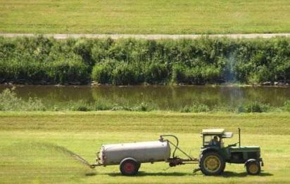
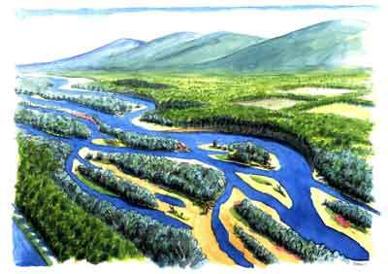
General principles and approaches
Holistic vs. sectoral
Apply river restoration in the broader context of river management
Consider the different claims to rivers
Conflicts (e.g. restoration vs. agricultural use), but also…
Synergies (e.g. restoration and flood protection, eco-services in general)
Stakeholder involvement, public participation
Conflicts
Synergies
Photos: Hydrotec, BUND
Notes:
Much easier to involve stakeholders in the planning phase prior to restoration, to take their concerns into consideration. Restoration projects are usually much easier to implement if they are supported by the local stakeholders.
A colleague always says: You have to talk, talk, and talk

Slide 7
General principles and approaches
Catchment vs. reach-scale restoration
Apply river restoration in a catchment context
Multiple pressures at different spatial scales → must be considered
Large-scale pressures (e.g. land use) can constrain reach-scale restoration
Hierarchy: Water pollution, nutrient / fine sediment, hydrology, morphology

Slide 8
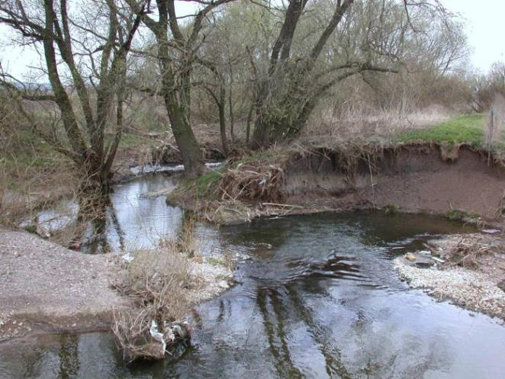
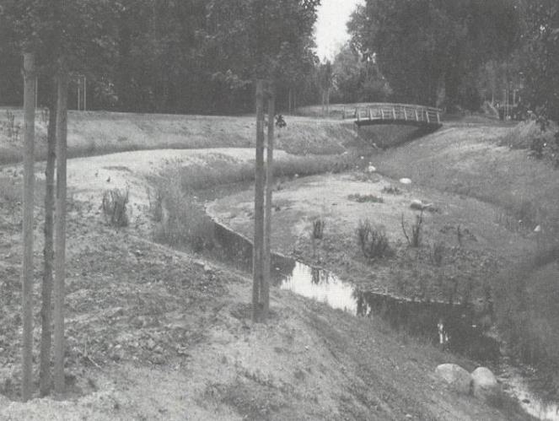
General principles and approaches
Processes vs. forms
Passive restoration: Restoring natural channel dynamics
Active restoration: Building channel features
Favour passive over active but not applicable in all reaches (e.g. altered morphogenic flows, sediment deficit, cohesive banks)
Passive restoration (processes)
Active restoration (forms)
Photo right: Patt et al. 1998

Slide 9
General principles and approaches
Processes vs. forms
Passive restoration: Restoring natural channel dynamics
Active restoration: Building channel features
Other pros and cons of the two approaches:
Passive restoration (processes)
Active restoration (forms)
cost, applicability (restrictions!)
sustainability, time to reach natural state

Slide 10
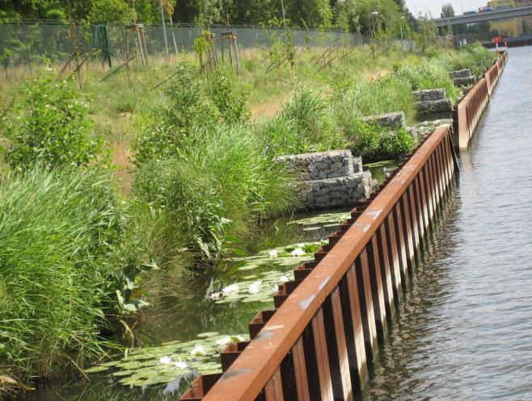
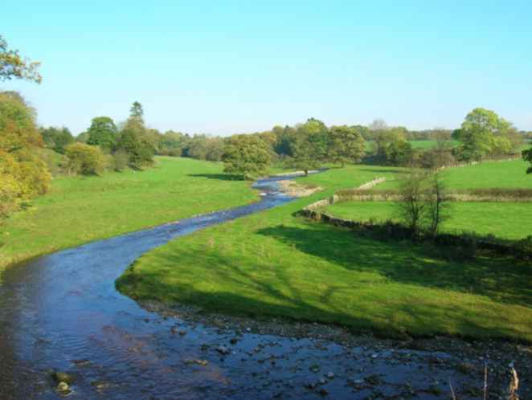
General principles and approaches
Biologically relevant vs. esthetically pleasing
New or limiting habitats created?
See things from a fish’s or invertebrate’s perspective!
Biologically relevant (if limiting)
Esthetically pleasing (effect?)
Photo right: Wallpaper.com

Slide 11
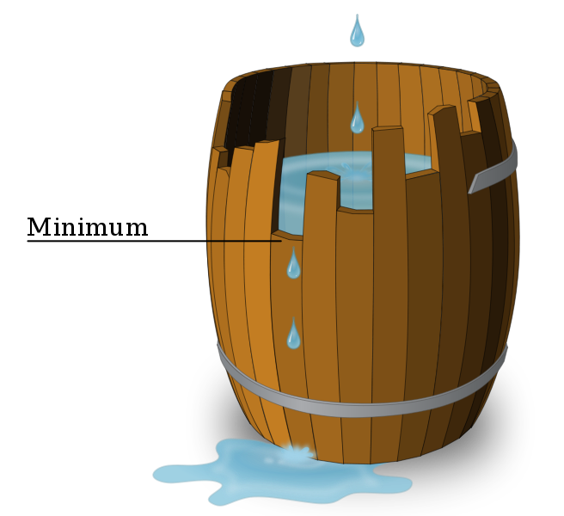
General principles and approaches
Bottlenecks vs. unspecific measures
Bottlenecks addressed?
Consider Liebigs “Law of the minimum”
Figure: Wikipedia

Slide 12
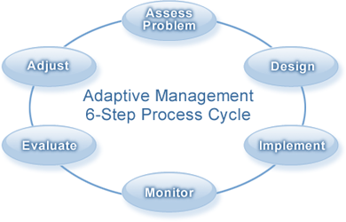
General principles and approaches
Adaptive management
Not (yet) possible to predict the effect of restoration
Necessary to monitor restoration effect
Adapting measures if necessary
Figure: N. Angelopoulos, http://www.for.gov.bc.ca

Slide 13
2
Restoration measures

Slide 14
Potential restoration measures
Restoration measure are applied at different spatial scales
Pressures at different spatial scales → measures at different spatial scales
Catchment scale
River network scale
Reach-scale
Notes:
Since the multiple-pressures act at different spatial scales, it is also necessary to implement restoration measures at different spatial scales, not “end-of-pipe”.

Slide 15
Potential restoration measures
Restoration measures for catchment scale pressures
Land use change (extensification, organic farming)
Waste water treatment
Reduce urban runoff and peak flows
Unsealing
Rainwater retention and infiltration
Rainwater retention basins
Rainwater infiltration systems

Slide 16
Potential restoration measures
Restoration measures for river network scale pressures
Source populations and stepping stones
Riparian buffer strips
River continuity

Slide 17
Potential restoration measures
Restoration measures for river network scale pressures
Source populations and stepping stones
Consider re-colonization potential (source population, migration barriers, dispersal abilities)
Establish source populations and stepping stones
Source population
Stepping stone
Restored reach
Figure: B. Heitmann, modified
Notes:
Only species which occur or live near the restored reach can colonize the new habitats => useful to check prior to restoration if source populations of the targeted species are present in the catchment and if they can colonize the restored reach

Slide 18
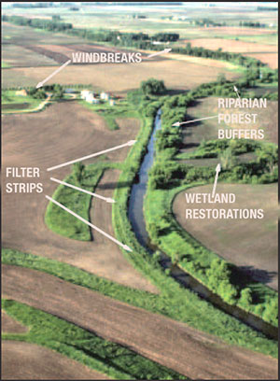
Potential restoration measures
Restoration measures for river network scale pressures
Riparian buffer strips
Effects
Nutrient / fine sediment retention
Shading / temperature
Organic matter input (leaves, large wood)
Habitat for aquatic (e.g. cover) and terrestrial life stages
Biota highly related to buffer land use
Potentially key restoration measure
Research need!
!
Photo: Ohio Department of Natural Resources

Slide 19
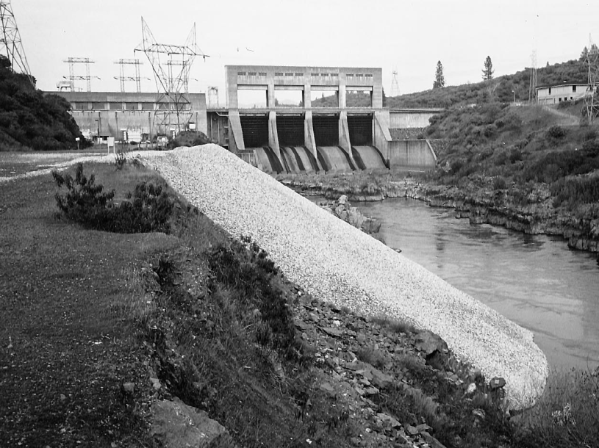
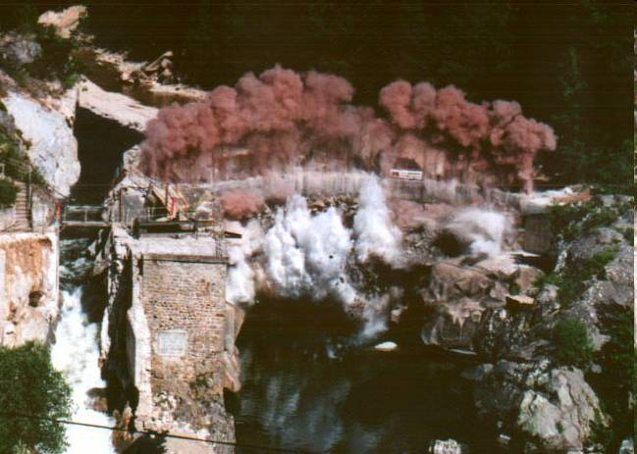
Potential restoration measures
Restoration measures for river network scale pressures
River continuity for fish BUT ALSO…
…for sediment transport!
Sediment input to mitigate sediment deficit – active restoration
Dam removal
Photo: M. Kondolf
Photo: France NN

Slide 20
Potential restoration measures
Restoration measures for reach scale pressures
Widely used / most common
Increasing lateral extent / restrictions
Instream
Riparian
Planform
Floodplain

Slide 21
Potential restoration measures
Restoration measures for reach scale pressures
Instream (mainly to increase habitat diversity)
Large wood and boulder placement
Sediment input
Create artificial bar or riffle (e.g. glides)
Manage aquatic vegetation
Creating habitats like cover or shallow wave-protected areas
Remove bed and bank fixation
…

Slide 22
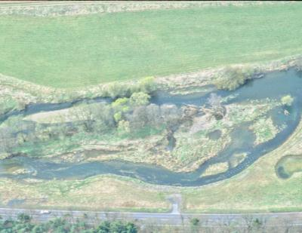
Potential restoration measures
Restoration measures for reach scale pressures
Planform
Re-meandering
Widening / re-braiding
Narrow over-widened channel
Create secondary floodplain
Initiate / tolerate natural channel dynamics
…
Middle photo: A. Lorenz
Notes:
When there is even more space available, e.g. in agricultural areas (exensively used like grassland and pasture), channel planform can be restored.

Slide 23
3
Restoration effect on morphology and biota
…and implications for future projects and selection of measures

Slide 24
Restoration effect
Key messages / conclusions of REFORM WP4
01 General: Monitor and adjust your project – nobody can fully predict restoration effects
02 Societal benefits: Restoration pays – it increases ecosystem services
03 Organism group: Terrestrial and semi-aquatic species benefit most from restoration
04 Measures: There is no single “best measure” but widening generally has a high effect
05 Biological metric: Restoration results in a higher number of individuals but few new species
05 Biological metrics: Restoration rather affects specific species or traits than increasing mere richness
06 Habitats: It is important to restore specific habitats not necessarily mere habitat diversity
07 Project size and age: Small restoration projects work but better act big and long-term
08 Catchment characteristics: Slightly higher effect in gravel-bed mountain rivers / low land-use pressure

Slide 25
Restoration effect
01 General
Monitor and adjust your project - nobody can fully predict restoration effects
Mainly info on simple metrics (richness, diversity) – objective?
Contrasting results
No effect
Positive effect
Notes:
There are mainly studies on the effect of restoration on simple biological metrics like richness and diversity. However, the mere increase of the number of species is not tantamount to an ecological enhancement, not really the main objective of river restoration.
sensitive, near-natural community
Therefore, future studies should focus on functional metrics / traits (as mentioned by Nicolai).
Moreover, the studies reported contrasting results

Slide 26
Restoration effect
01 General
Monitor and adjust your project - nobody can fully predict restoration effects
Mainly info on simple metrics (richness, diversity) – objective?
Contrasting results
Meta-analysis: high variability, ~$1/3$no or negative effect
Kail et al. (2015)

Slide 27
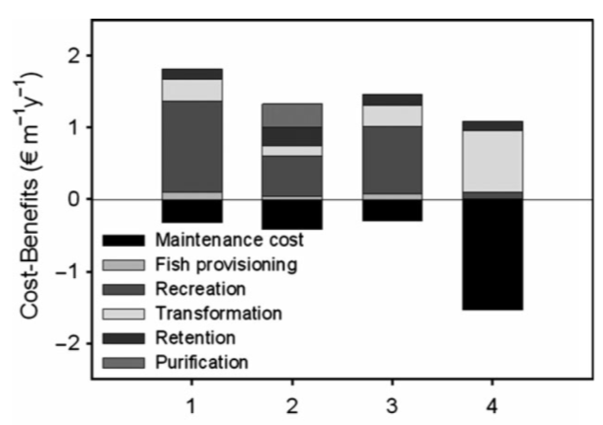
Restoration effect
02 Societal benefits
Restoration pays – it increases ecosystem services
Few studies (research need!)
Restoration increases ES (total economic value)
Depends on assumptions?
→Select measures to maximise overall benefit
Acuña et al. (2013), Vermaat et al. (2015)
Notes:
TEV = total economic value (actually partial TEV since not all ecosystem services were considered)
Acuna et al. (2013): Reach-scale partial TEV is given for the four study reaches (numbered 1 to 4). The partial TEV of the restored reaches is 10-100 times the partial TEV prior to restoration.

Slide 28
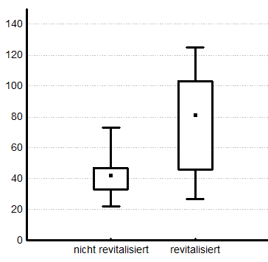
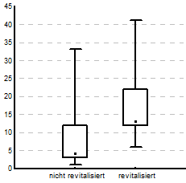
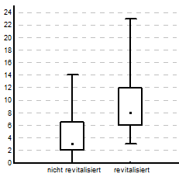
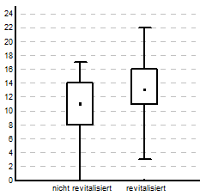
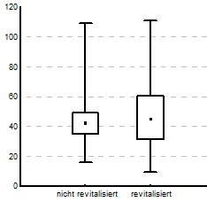
Restoration effect
03 Organism group
Terrestrial and semi-aquatic species benefit most from restoration
Higher richness (short term, few years)
Floodplain vegetation
Ground beetles
Macrophytes
p < 0.01
p < 0.01
p < 0.01
Degraded Restored
Degraded Restored
Degraded Restored
Fish
Macroinvertebrates
p < 0.01
n.s.
Jähnig et al. (2009)
Degraded Restored
Degraded Restored

Slide 29
Restoration effect
03 Organism group
Terrestrial and semi-aquatic species benefit most from restoration
Higher richness (short term, few years)
Kail et al. (2015)

Slide 30
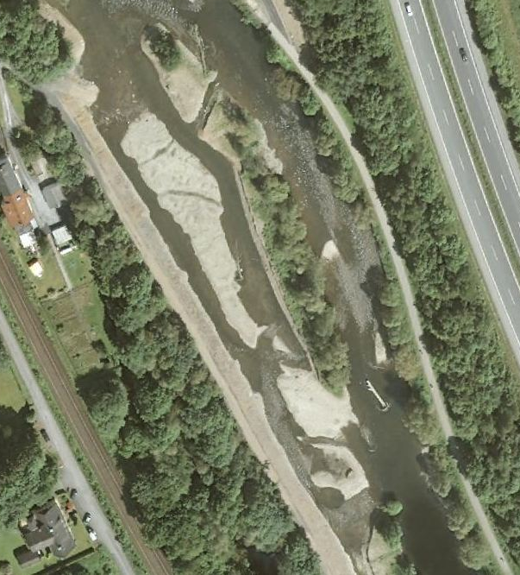
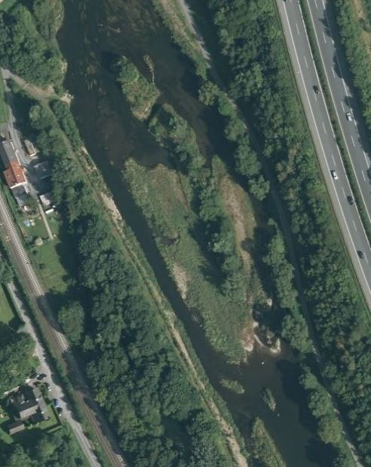
Restoration effect
03 Organism group
Terrestrial and semi-aquatic species benefit most from restoration
Higher richness (short term, few years)
Mainly widening projects (pioneer habitats, early successional stages)
Long-term effects?
2010
2012
Ruhr near Binnerfeld R2, Germany, restored in 2009

Slide 31
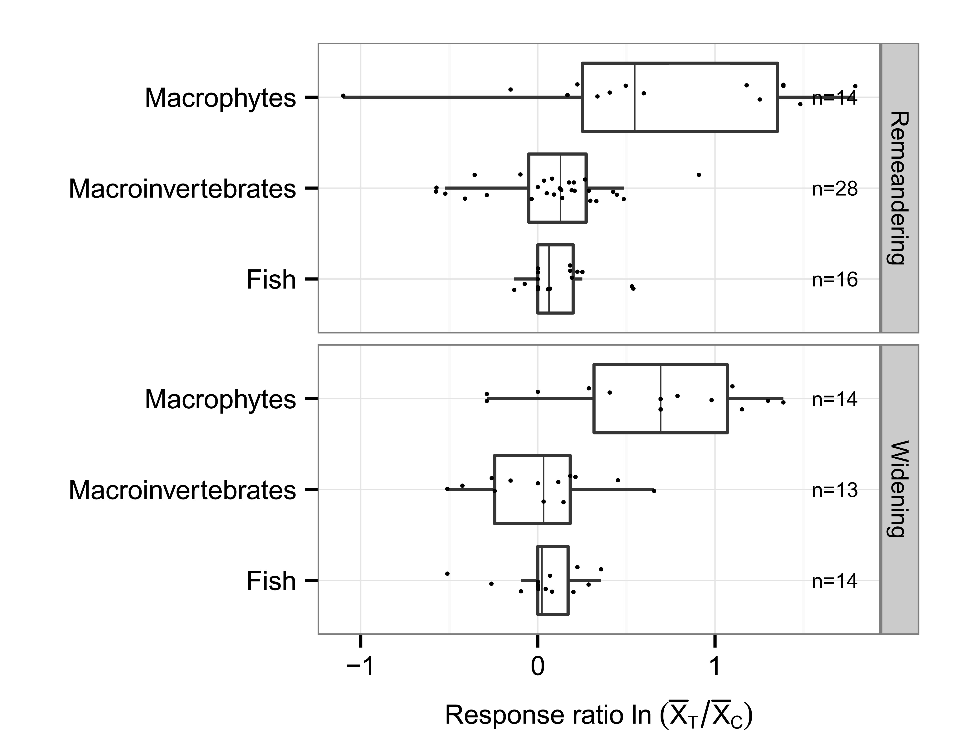
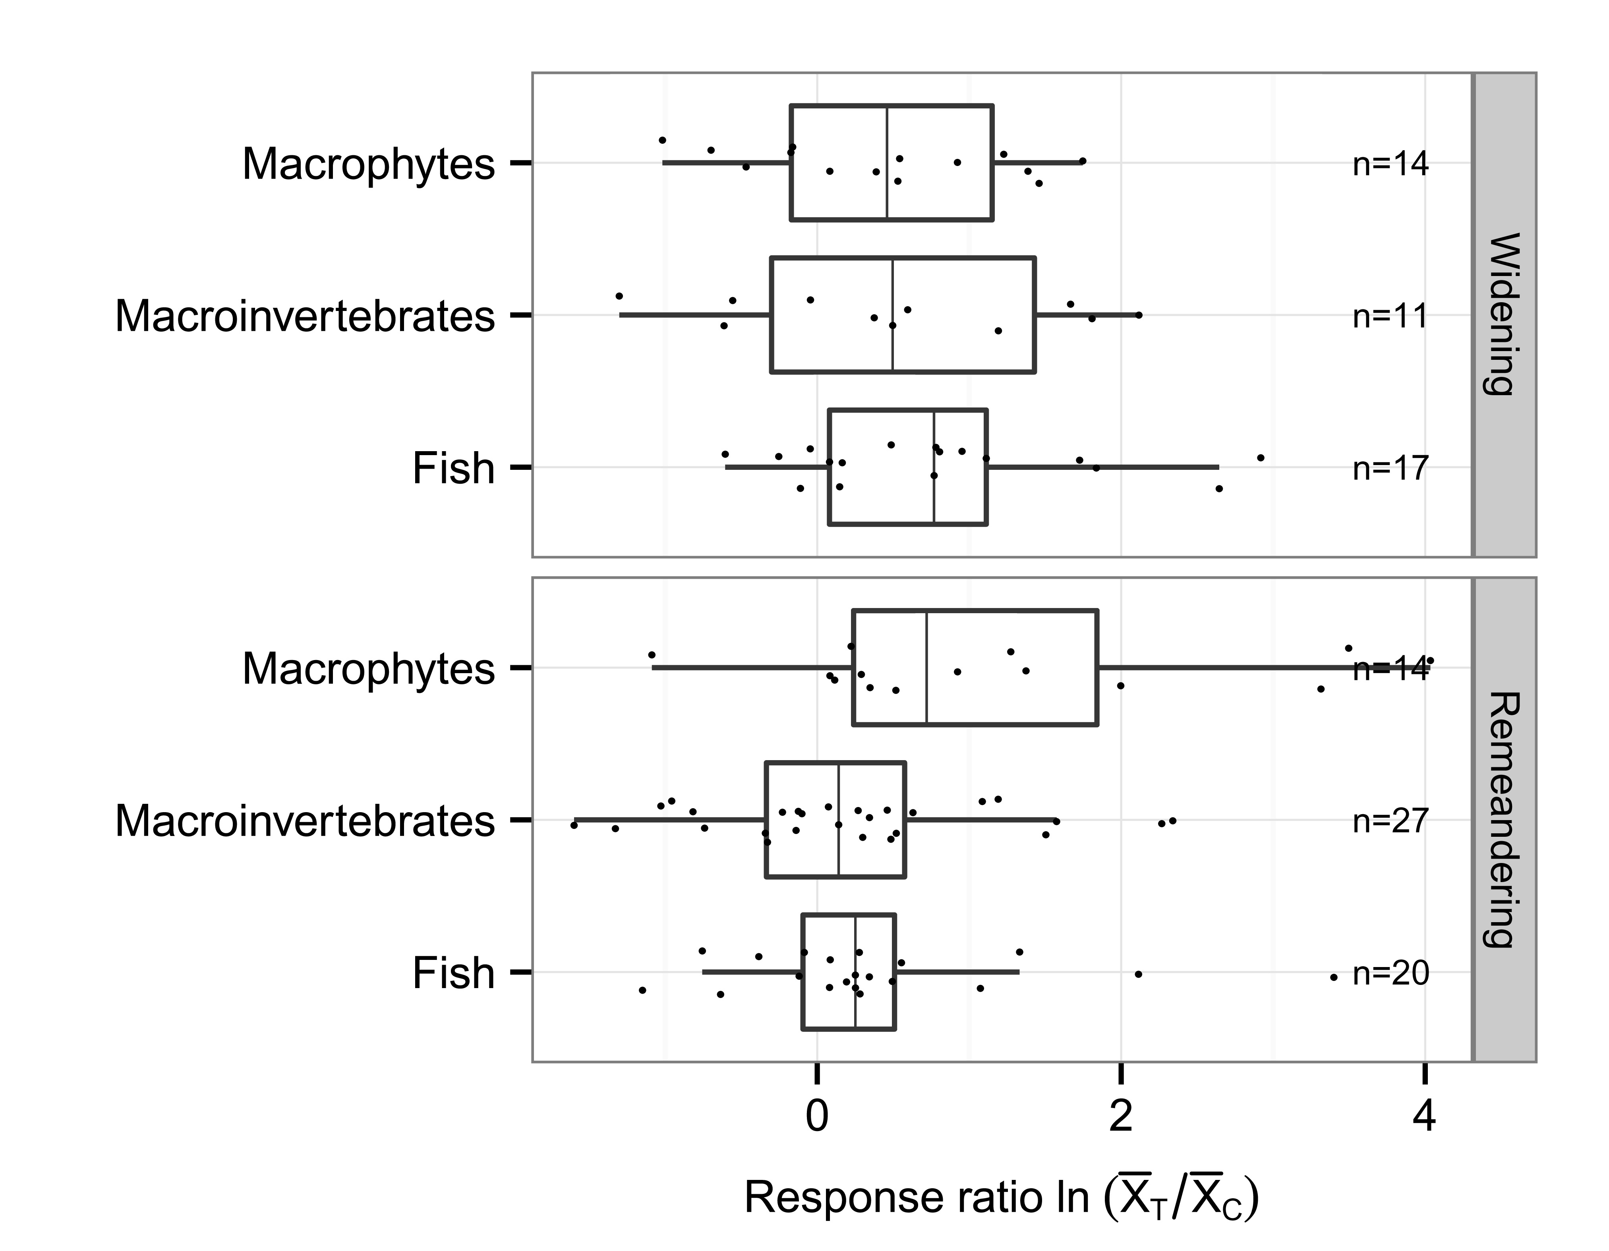
Restoration effect
04 Restoration measures
There is no single “best measure” but widening generally has a high effect
High effect especially on macrophytes…
Richness/diversity
Abundance/biomass
Kail et al. 2015

Slide 32
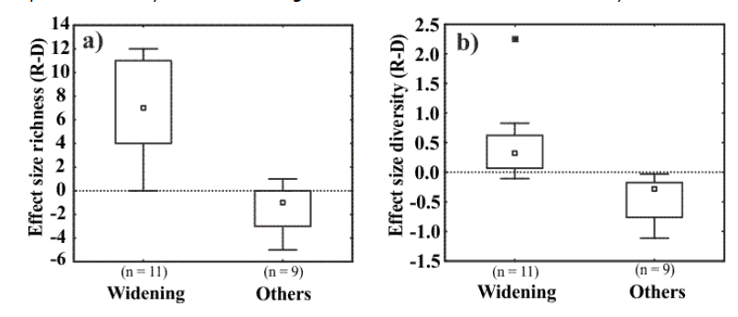
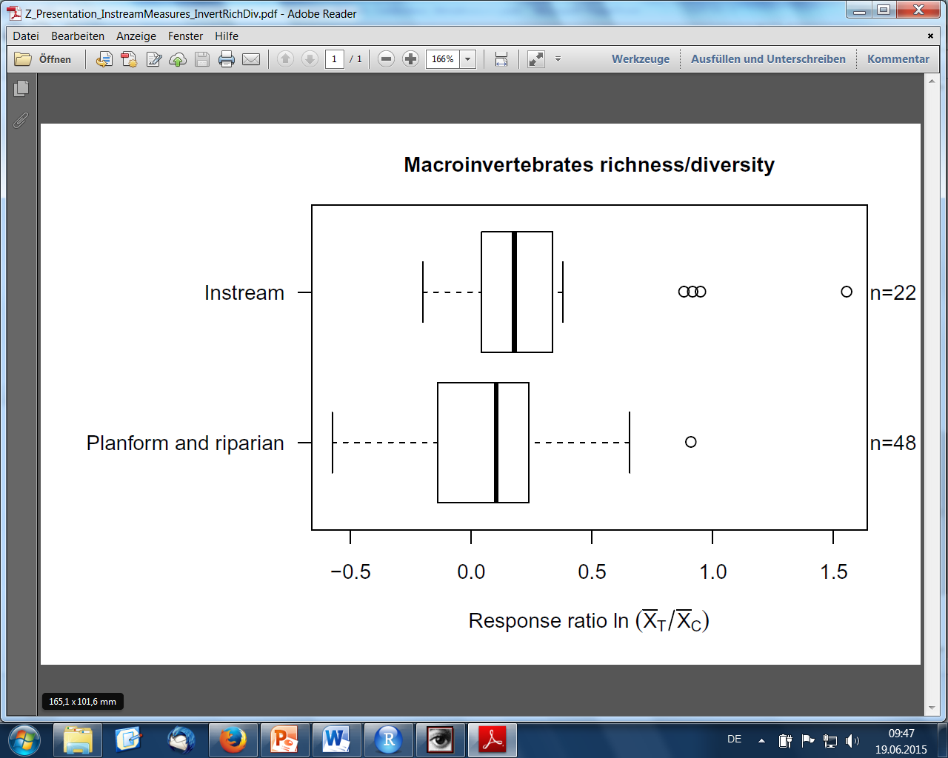
Restoration effect
04 Restoration measures
There is no single “best measure” but widening generally has a high effect
High effect especially on macrophytes and ground beetles
Instream measures highest effect on fish, macroinvertebrates
Ground beetle richness and diversity
Januschke and Verdonschot (2015)
Kail et al. (2015)

Slide 33
Restoration effect
03 Organism group 04 Restoration measures
→ Select measures for targeted organism group
→ Restore natural morphodynamics to rejuvenate habitats

Slide 34
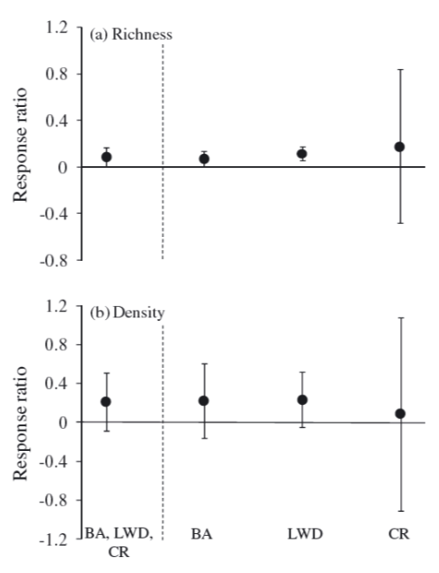
Restoration effect
05 Biological metric
Restoration results in a higher number of individuals but few new species
Abundance/biomass > richness/diversity (fish, macroinvertebrates)
Miller et al. (2010)
(Kail et al. (2015)

Slide 35
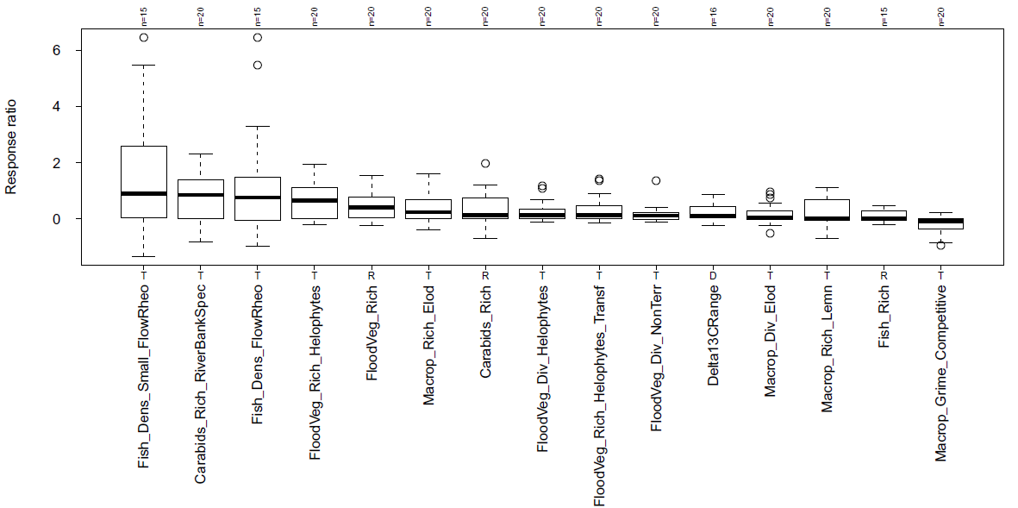
Restoration effect
05 Biological metric
Restoration rather affects specific traits than increasing mere richness
Fish: small rheophilic fish (abundance)
Ground beetles: Sparsely vegetated river banks specialists
Floodplain veg.: Helophytes (emergent but rooting in wetted soils)
Januschke and Verdonschot (2015), Göthe et al. (2015), Schmutz et al. (2015), figure summary analysis unpublished
Notes:
In the figure, only biological metrics are shown for which the response ratio (effect of restoration) was significantly different from zero (Wilcoxon test) in the REFORM dataset of the 20 case-studies (each compared to a nearby non-restored section to quantify the effect of restoration as the difference restored minus degraded). Most of these metrics are functional metrics / traits.
The functional metrics/traits indicate how restoration has changed the abiotic habitat conditions and allows to infer causal relationships (other than mere species richness or diversity).

Slide 36
Restoration effect
05 Biological metric
Easier to increase abundance, difficult to establish new species
Set realistic objectives, e.g.:
fish richness in small mountain streams is low naturally
re-colonization potential might be limited (source pop. missing)

Slide 37
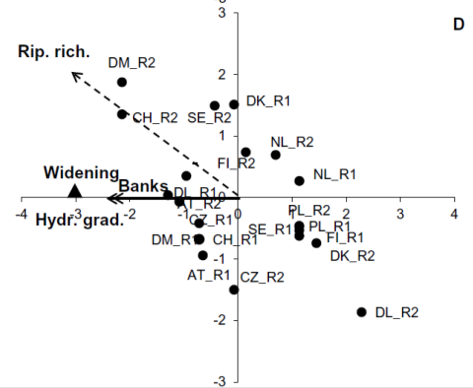
Restoration effect
06 Habitats
It is important to restore specific habitats not mere habitat diversity
Ground beetles: sparsely vegetated bars and banks
Januschke and Verdonschot (2015)

Slide 38
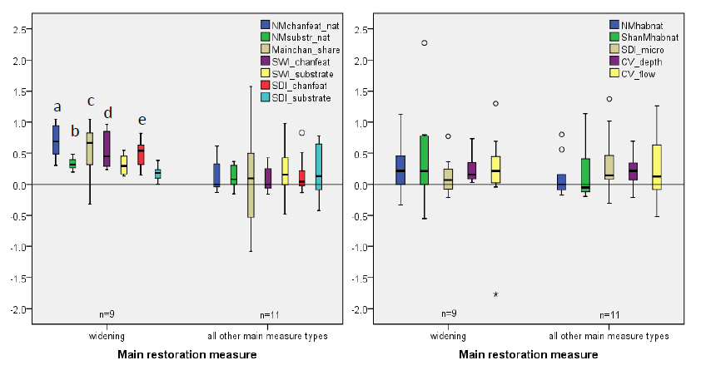
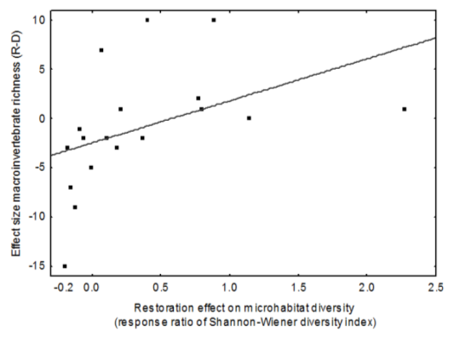
Restoration effect
06 Habitats
It is important to restore specific habitats not mere habitat diversity
Ground beetles: sparsely vegetated bars and banks
Macroinvertebrates: microhabitat (substrate) diversity (low effect on microhabitats may explain low effect on inverts)
→ Select measures which restore specific habitats at relevant scales
Hymo: mesohabitat
Hymo: microhabitat
Verdonschot et al. (2015)
Poppe et al. (2015)
Notes:
Macroinvertebrates depend on microhabitats (diversity). However, many restoration projects increase mesohabitat diversity but NOT microhabitat diversity => It might look esthetically pleasing and positive for ecologists but the microhabitats necessary for e.g. inverts are still missing!!

Slide 39
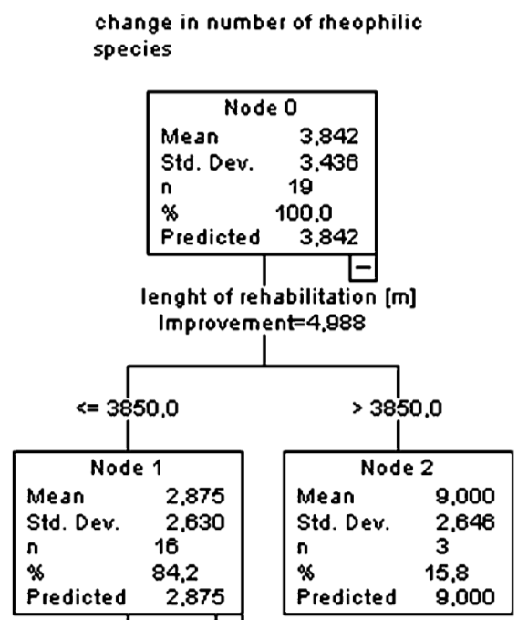
Restoration effect
07 Project size and age
Small restoration projects work but better act big and long-term
Restoration effect does only depend on size if projects are large
Schmutz et al. (2014)

Slide 40
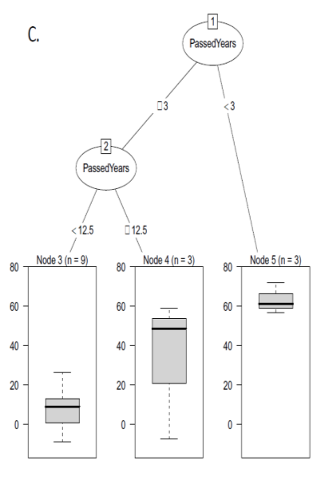
Restoration effect
07 Project size and age
Small restoration projects work but better act big and long-term
Restoration effect does only depend on size if projects are large
Restoration effect depends on project age, but no simple increase!
Do short-term effects (pioneer stages) vanish over time?
3 - 12.5y
>12.5y
<3y
Kail et al. (2015), Schmutz et al. (2015)

Slide 41
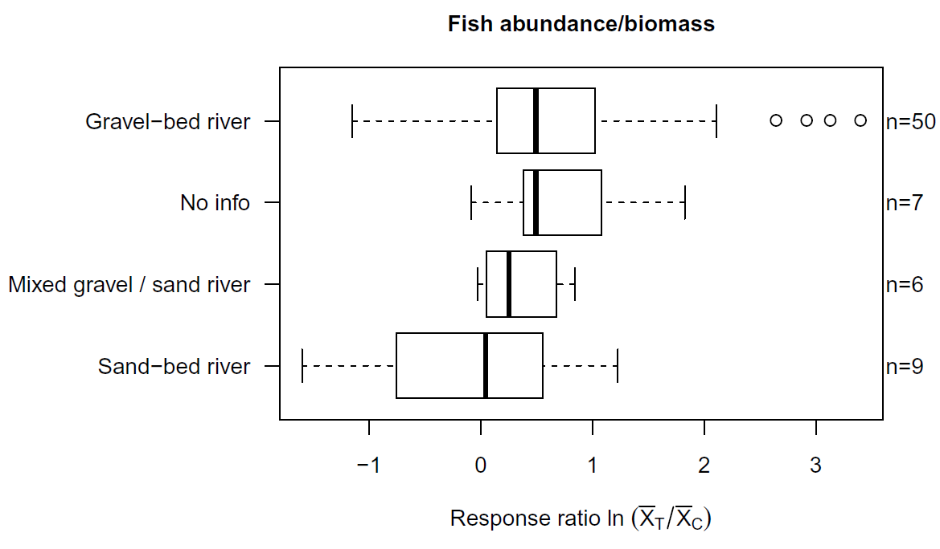
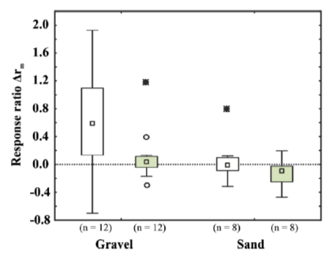
Restoration effect
08 Catchment / river characteristics
Slightly higher effect in gravel-bed mountain rivers / low land-use pressure
Gravel-bed > sand bed, mountain > lowlands, widening > other
…but highly co-correlated
Ground beetle
richness
diversity
Kail et al. (2015
Januschke and Verdonschot (2015)

Slide 42
Restoration effect
Further readings
Peer-reviewed scientific literature (> 300 papers)
REFORM WP4 deliverable D4.2 (meta-analysis)
http://www.reformrivers.eu/evaluation-hydromorphological-restoration-existing-data
Kail et al. (2015, Ecological Indicators)
REFORM WP4 deliverable D4.3 (20 case-studies)
http://www.reformrivers.eu/results/effects-of-river-restoration
Hering et al. (2015, Journal of Applied Ecology)
Hydrobiologia special issue (several papers)
REFORM WP4 deliverable D4.4 (ecosystem services)
http://reformrivers.eu/assessing-societal-benefits-river-restoration-using-ecosystem-services-approach
Vermaat et al. (2015, Hydrobiologia)

Slide 43
Summary
How can we improve? - selection of measures
Set clear, measurable, realistic objectives (given catchment and river char.)
Identify main pressures / bottlenecks
Select appropriate approach
catchment or reach-scale sufficient?
passive or active restoration?
Select measures and consider
river type (e.g. low dynamics with cohesive banks, gravel-bed>sand-bed)
targeted organism group (terrestrial, semi-aquatic, aquatic)
specific habitat needs (e.g. microhabitats)
possible constraints (e.g. source pop., water quality, hydrology, sediment)

Slide 44
Summary
How can we improve? - selection of measures
Set clear, measurable, realistic objectives (given catchment and river char.)
Identify main pressures / bottlenecks and constraints!
Select appropriate approach
catchment or reach-scale sufficient?
active or passive restoration?
Select measures and consider river type, organism group, constraints…
Monitoring (high variability, changes over time)
Assess (including terrestrial groups and ES)
Adaptive management
Try!

